Slide 1

AASD 4000
Machine Learning - I
Applied AI Solutions Developer Program

Slide 2
Module 8
ML Algorithms - I
Vejey Gandyer

Slide 3
Decision Tree

Slide 4
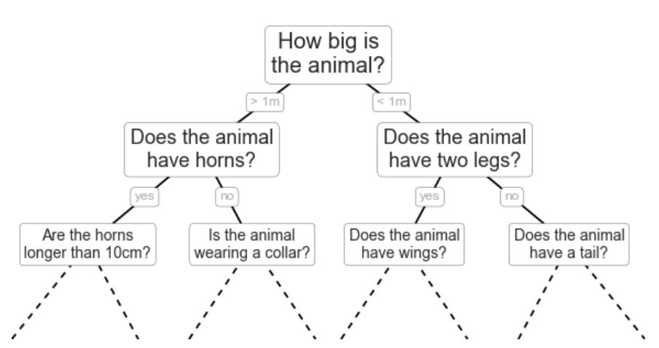
Decision Tree
Non-parametric algorithm
Ask a series of questions designed to zero-in on the classification
Eg: To classify an animal, ask these questions to narrow down the decision process of classifying it
Each question will cut the number of options by half, quickly narrowing down the options.
Which questions to ask at each step???

Slide 5
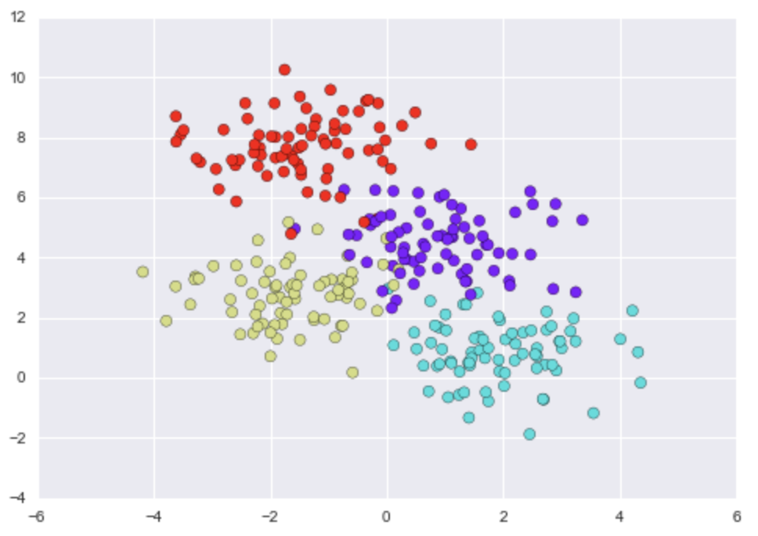
Decision Tree
Use make_blobs()
Iteratively split the data along one or the other axis according to some quantitative criterion
At each level assign the label of the new region according to a majority vote of points within it

Slide 6
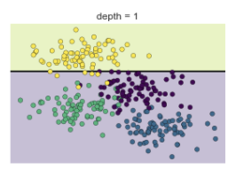
Decision Tree
After first split, every point in the upper branch remains unchanged, so there is no need to further subdivide this branch
Only split further if all nodes are not of one colour (class)

Slide 7
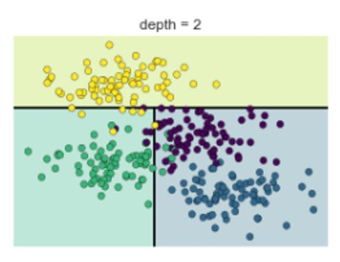
Decision Tree
After second split, every point in the lower left branch remains unchanged, so there is no need to further subdivide this branch even though it has one or two outliers from other classes
Over-fitting happens when there is too much sub-divisions

Slide 8
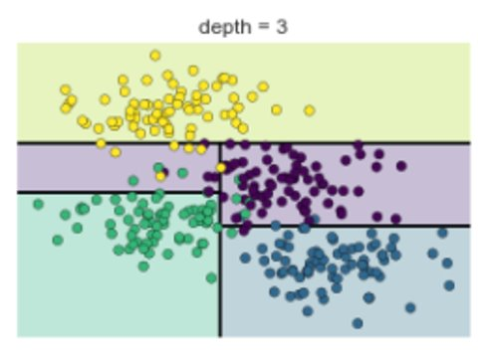
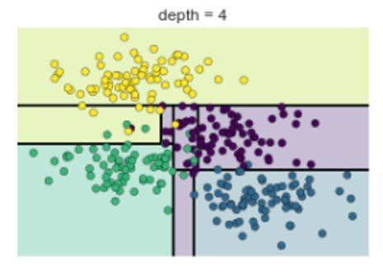
Decision Tree Splitting

Slide 9
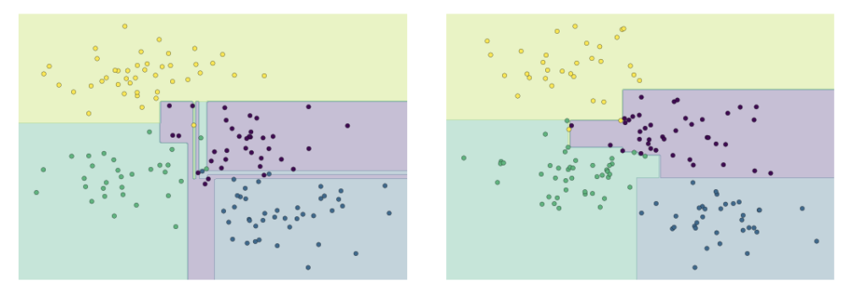
Decision Tree – Over-fitting
Combining two trees' results would help !!

Slide 10
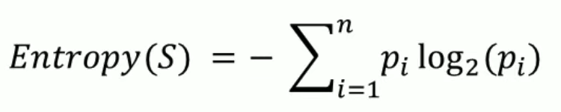
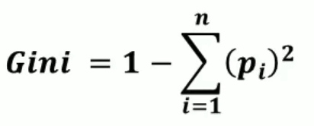

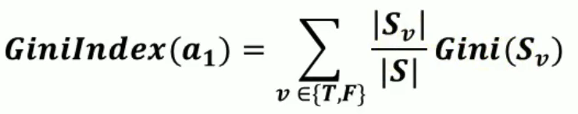



Math... a little bit

Slide 11
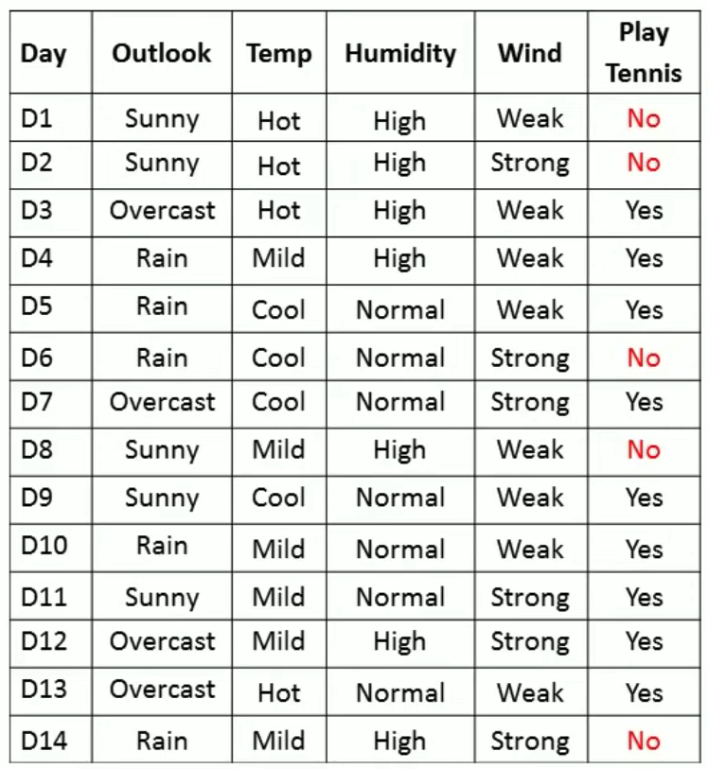

Case Study – Hand Computation
Attribute: Outlook
S = [9+, 5-]
S_{Sunny} = [2+, 3-]
S_{Overcast} = [4+, 0-]
S_{Rain} = [3+, 2-]
Entropy(S) =
Entropy(S_{Sunny}) =
Entropy(S_{Overcast}) =
Entropy(S_{Rain}) =
Gain(S, Outlook) =

Slide 12
Temp Attribute
Attribute: Temp
S = [9+, 5-]
S_{Hot} = [2+, 2-]
S_{Mild} = [4+, 2-]
S_{Cool} = [3+, 1-]
Entropy(S) =
Entropy(S_{Hot}) =
Entropy(S_{Mild}) =
Entropy(S_{Cool}) =
Gain(S, Temp) =

Slide 13
Humidity Attribute
Attribute: Humidity
S = [9+, 5-]
S_{High} = [3+, 4-]
S_{Normal} = [6+, 1-]
Entropy(S) =
Entropy(S_{High}) =
Entropy(S_{Normal}) =
Gain(S, Humidity) =

Slide 14
Wind attribute
Attribute: Wind
S = [9+, 5-]
S_{Strong} = [3+, 3-]
S_{Weak} = [6+, 2-]
Entropy(S) =
Entropy(S_{Strong}) =
Entropy(S_{Weak}) =
Gain(S, Wind) =

Slide 15
Choose the best attribute to split
Gain(S, Outlook) =
Gain(S, Temp) =
Gain(S, Humidity) =
Gain(S, Wind) =

Slide 16
Draw Decision Tree with the chosen splitting attribute
Outlook
Sunny
Overcast
Rain
[2+, 3-]​
[4+, 0-]​
[3+, 2-]​
?
YES
?

Slide 17
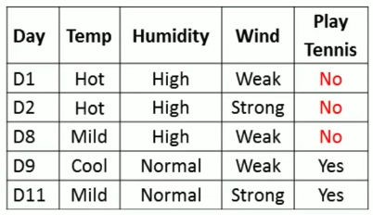
Calculate the next attribute for split

Slide 18
Calculate the next attribute for split
Attribute: Temp
S_{Sunny} = [2+, 3-]
S_{Hot} = [0+, 2-]
S_{Mild} = [1+, 1-]
S_{Cool} = [1+, 0-]
Entropy(S_{Sunny}) =
Entropy(S_{Hot}) =
Entropy(S_{Mild}) =
Entropy(S_{Cool}) =
Gain(S_{Sunny}, Temp) =

Slide 19
Calculate the next attribute for split
Attribute: Humidity
S_{Sunny} = [2+, 3-]
S_{High} = [0+, 3-]
S_{Normal} = [2+, 0-]
Entropy(S_{Sunny}) =
Entropy(S_{High}) =
Entropy(S_{Normal}) =
Gain(S_{Sunny}, Humidity) =

Slide 20
Calculate the next attribute for split
Attribute: Wind
S_{Sunny} = [2+, 3-]
S_{Strong} = [1+, 1-]
S_{Weak} = [1+, 2-]
Entropy(S_{Sunny}) =
Entropy(S_{Strong}) =
Entropy(S_{Weak}) =
Gain(S_{Sunny}, Wind) =

Slide 21
Choosing best next attribute for split
Gain(S_{Sunny}, Temp) =
Gain(S_{Sunny}, Humidity) =
Gain(S_{Sunny}, Wind) =

Slide 22
Draw Decision Tree with the chosen splitting attribute
Outlook
Sunny
Overcast
Rain
[2+, 3-]​
[4+, 0-]​
[3+, 2-]​
?
YES
Humidity
?
High
Normal
[0+, 3-]​
[2+, 0-]​
NO
YES

Slide 23
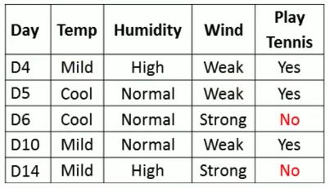
Calculate the next attribute for split

Slide 24
Calculate the next attribute for split
Attribute: Temp
S_{Rain} = [3+, 2-]
S_{Hot} = [0+, 0-]
S_{Mild} = [2+, 1-]
S_{Cool} = [1+, 1-]
Entropy(S_{Rain}) =
Entropy(S_{Hot}) =
Entropy(S_{Mild}) =
Entropy(S_{Cool}) =
Gain(S_{Rain}, Temp) =

Slide 25
Calculate the next attribute for split
Attribute: Humidity
S_{Rain} = [3+, 2-]
S_{High} = [1+, 1-]
S_{Normal} = [2+, 1-]
Entropy(S_{Rain}) =
Entropy(S_{High}) =
Entropy(S_{Normal}) =
Gain(S_{Rain}, Humidity) =

Slide 26
Calculate the next attribute for split
Attribute: Wind
S_{Rain} = [3+, 2-]
S_{Strong} = [0+, 2-]
S_{Weak} = [2+, 0-]
Entropy(S_{Rain}) =
Entropy(S_{Strong}) =
Entropy(S_{Weak}) =
Gain(S_{Rain}, Wind) =

Slide 27
Choosing best next attribute for split
Gain(S_{Rain}, Temp) =
Gain(S_{Rain}, Humidity) =
Gain(S_{Rain}, Wind) =

Slide 28
Draw Decision Tree with the chosen splitting attribute
Outlook
Sunny
Overcast
Rain
[2+, 3-]​
[4+, 0-]​
[3+, 2-]​
?
YES
Humidity
?
Wind
High
Normal
Strong
Weak
[0+, 3-]​
[2+, 0-]​
[0+, 2-]​
[3+, 0-]​
NO
YES
NO
YES

Slide 29
Caveats
How to deal with CONTINUOUS VALUED ATTRIBUTES?
Sort the attribute values
Find discontinuities between Class changes
Compute averages of those discontinuities
Find Gains for these averages (thresholds)
Choose the threshold with the best Gain as splitting attribute
How to avoid OVERFITTING?
Random Forest

